Slide 1

Outlet Staging Plan for February 2020
Marketing

Slide 2
Outline
This plan will help to understand which POSM will be available at outlets during the month of February
According to this plan, old POSM to be removed and new POSM to be executed
Some POSM of running product/campaign will continue

Slide 3
Plan for Feb 2020
Model / Campaign | Distribution Week | Outlet No | Store Front |  |  |  |  | In Store |  |  |  |  | Experience Zone |  |  | Remarks
 |  |  | X Banner | Poster | Festoon | Shop screen | Bunting | Dangler | Sticker | Shelf Highlighter | Leaflet | Poster | Ceiling Banner | Table Top | Leaflet
Z15 | W3, May | 500 | S |  |  |  |  | S |  |  | S |  |  |  | S | Stay
i68 | W1, Oct | 1.6k |  |  | S |  |  |  |  |  | S |  |  |  | S | Stay
Z20 | W3, Nov | 1k | S |  |  |  |  |  |  |  | S |  | S |  | S | Stay
I18 Price Cut | W1, Dec | 3.5k |  |  |  | S |  |  | S |  |  |  |  |  |  | Stay
GP | W4, Dec | 2.5k |  |  |  |  |  |  |  |  | S |  |  |  | S | Stay
Z12 | W4, Dec | 1.7k | S |  |  |  |  | S |  |  | S |  |  |  | S | Stay
Z25 | W4, Dec | 1.7k | S |  |  |  |  |  |  |  | S |  | S |  | S | Stay
Price Cut | W4, Jan | 1.7k |  |  | S |  |  |  | S (GB) |  | S |  |  |  | S | Stay
New Model | W4, Feb | 1.7k | S |  |  | S |  | S |  |  | S |  | S |  |  | Upcoming

Slide 4
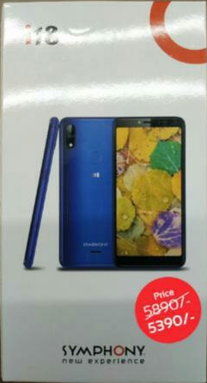
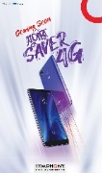
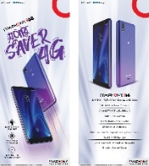
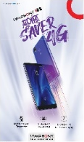







POSM to Continue
Campaign | POSM items | Creative
I18 Price Cut | Shop screen Sticker
Z12 | X-Banner Leaflet Dangler
I97 & i95 Price Cut | Festoon Leaflet Sticker
Campaign | POSM items | Creative
i68 | Leaflet Festoon
Z25 | X-Banner Ceiling Banner Leaflet
GP | Leaflet

Slide 5
February POSM (Upcoming)
Campaign | POSM items | Distribution Week | Creative
New Model | X-Banner Shop Screen Leaflet Dangler Ceiling Banner | W4, Feb | WIP

Slide 6














POSM Execution Guideline: EO
POSM | Models
X-Banner | Z12, Z25
Festoon | I68, Price Cut
Shopscreen | i18
C. Banner | Z25
Dangler | Z12
Leaflet | Z12, i68, Z25, GP, Price Cut
Table Top
1 Shopscreen in store front at the ceiling
10-12 Danglers at the ceiling
Leaflet to be placed on the Smart Table (100 pcs)
Max 2 X-banner and 2 Festoon at the most visible place of EO store front
1 Ceiling Banner on top of Smart Table from Ceiling. New Model Must display

Slide 7
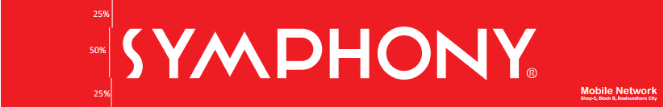
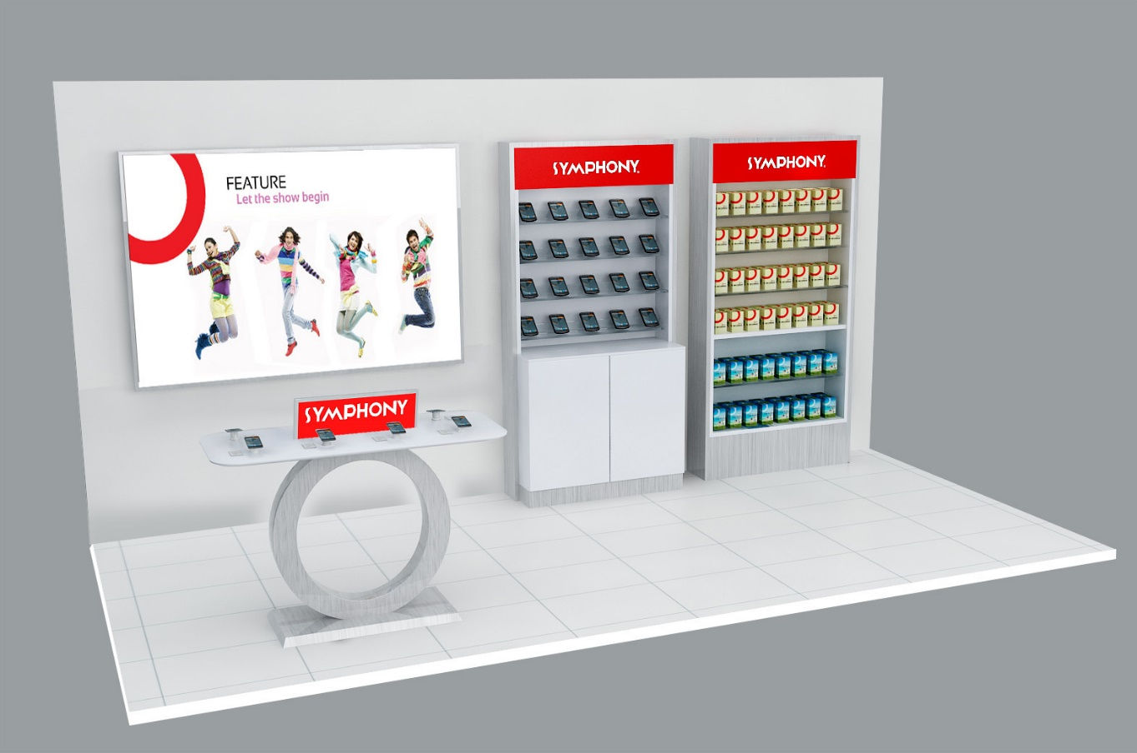




POSM Execution Guideline: SIS
POSM | Models
X-Banner | Z12, Z25
Festoon | I68, Price Cut
Shopscreen | i18
C. Banner | Z25
Dangler | Z12
Leaflet | Z12, i68, Z25, GP, Price Cut
Table Top
1 Shopscreen in store front from Ceiling
1 Ceiling Banner on top of Smart Table from Ceiling
6-8 Danglers at the ceiling
Leaflet to be placed on the Smart Table/ Counter (50 pcs)
Max 2 pcs festoon at store front

Slide 8
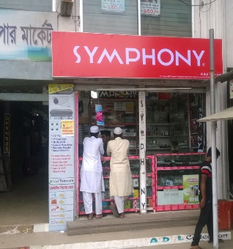



POSM Execution Guideline: GO
POSM | Models
Festoon | I68, Price Cut
Shopscreen | i18
C. Banner | Z25
Dangler | Z12
Leaflet | Z12, i68, GP, Z25, Price Cut
Poster/Sticker
1 Ceiling Banner & 4-6 Danglers at the ceiling
Leaflet to be given to retailer for consumer communication (30 pcs)
1 Festoon at the most visible place of GO store front
1 Poster of each type on the wall

Slide 9
Thank You

